Slide 1

Electromagnetics
Required/Elective: Required First and Elective Later
Credits: 3 Units, 3 Hours in Every Week
Class: (Undergraduate Students)
Time: Class Periods 6, 7, 8 / A, B, C on Every Tuesday / Saturday
Location: Classroom 204, 2nd Lecture Hall / 302, 3rd Lecture Hall
Facility: e-Desk or (Notebook Computer + Overhead Projector)
Taping: Audio and Video Taping Prohibited
Lecturer: Cheng-Chieh Yu (余政杰), Prof., Ph.D.
E-Mail: ccyu@ntut.edu.tw
Digital Wireless Lab
Department of Electronic Engineering
Graduate Institute of Computer and Communication Engineering
College of Electrical Engineering and Computer Science
National Taipei University of Technology
2019.02.19, Tuesday

Slide 2
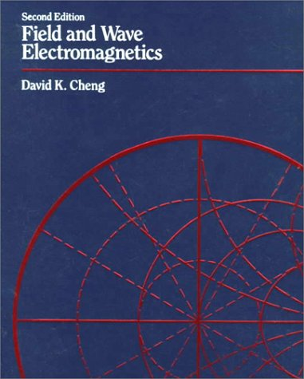
Reference Book # 1
2

Slide 3

Reference Book # 2

Slide 4
References
01. D. K. Cheng, Field and Wave Electromagnetics, 2nd Ed., Addison Wesley, 1989. 02. N. N. Rao, Elements of Engineering Electromagnetics, 6th Ed., Pearson, 2004.
03. S. M. Wentworth,
Fundamentals of Electromagnetics with Engineering Aplications, Wiley, 2006.
04. http://en.wikipedia.org/
4

Slide 5
Electrostatic Field
Chapter 01

Slide 6
Scalar Quantity
A quantity, such as mass, length, or width, that is completely specified by its magnitude and has no direction.
6

Slide 7
Vector Quantity
A quantity, such as velocity, completely specified by a magnitude and a direction.
7

Slide 8
Field
A field is a spatial distribution of a quantity, which may or may not be a function of time.
8

Slide 9
Basic EM Quantities and Relations
1. Source Quantities: Charge Density (ρ) Electric Current Density Vector (J) 2. Field Quantities: Electric Field Intensity Vector (E) Electric Flux Density Vector (D) Magnetic Field Intensity Vector (H) Magnetic Flux Density Vector (B) 3. Constitutive Relations: Relation Between D and E by ε Relation Between B and H by μ Relation Between J and E by σ

Slide 10
Lorentz Force
10

Slide 11
Coulomb’s Law
Coulomb’s law was first published in 1785 by French physicist Charles Augustin de Coulomb and was essential to the development of the theory of electromagnetism.

Slide 12
Coulomb’s Law
Coulomb's law or Coulomb's inverse-square law, is a law of physics describing the electrostatic force, F_{e}, between electrically charged particles.

Slide 13
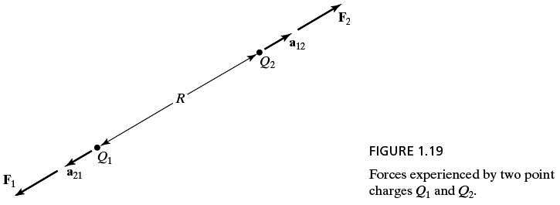
Coulomb’s Law

Slide 14
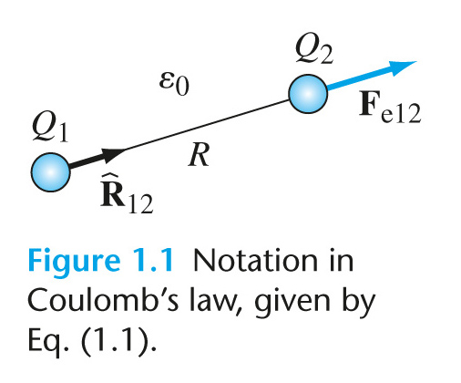

Slide 15
15
15

Slide 16
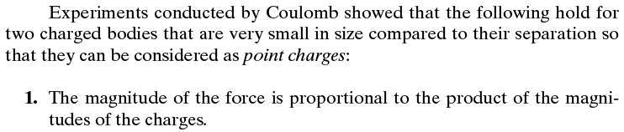
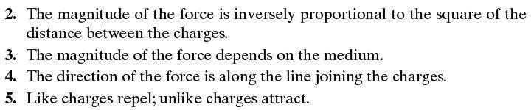
Coulomb’s Law

Slide 17
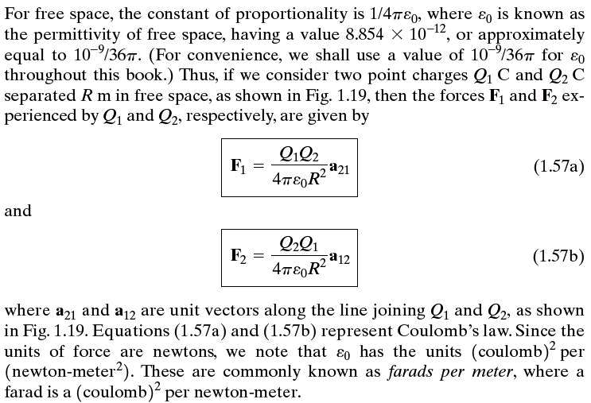

Slide 18
18
18

Slide 19
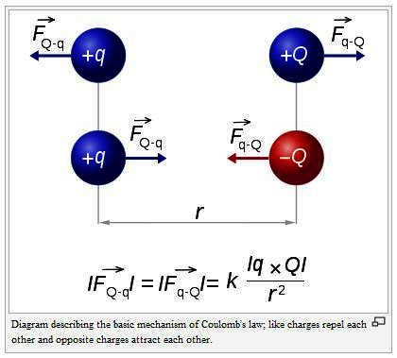

Slide 20
Coulomb’s Law
A positive force implies it is repulsive, while a negative force implies it is attractive.

Slide 21
Electric Field Intensity Vector (E)
Electric field intensity vector is the distribution in space of the strength and direction of forces that would be exerted on an electric charge at any point in that space. Electric fields themselves result directly from other electric charges or from changing magnetic fields.

Slide 22
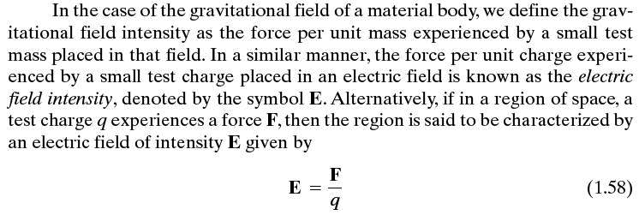
Electric Field Intensity Vector (E)

Slide 23
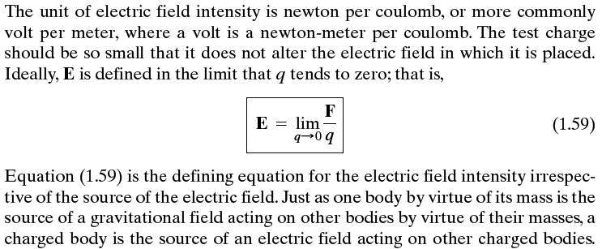
Electric Field Intensity Vector (E)

Slide 24
Electric Force
The electric field intensity vector is quantitatively defined through the force on a small probe point charge q moving at rest in the electric field, which equals the product of q and E.
24

Slide 25
Electric Flux Density Vector (D)
Electric flux density is a measure of the number of electric lines of force passing through a given area. It is equal to the electric field intensity multiplied by the permittivity of the material through which the electric field extends. It is measured in coulombs per square meter.

Slide 26
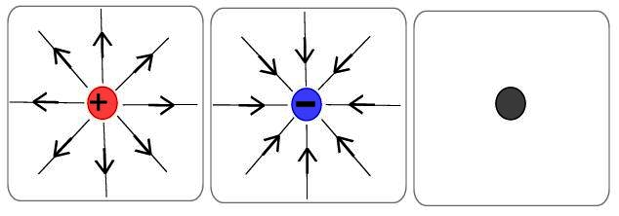
Electric Flux Density Vector (D)

Slide 27
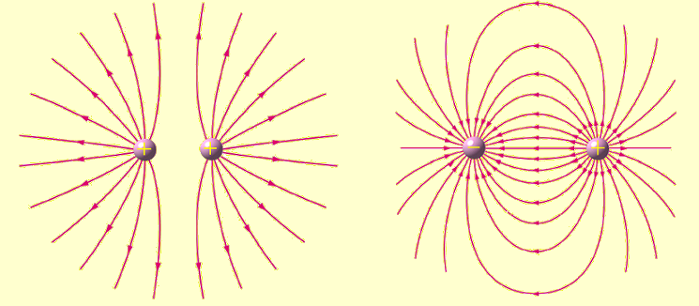
Electric Flux Density Vector (D)

Slide 28
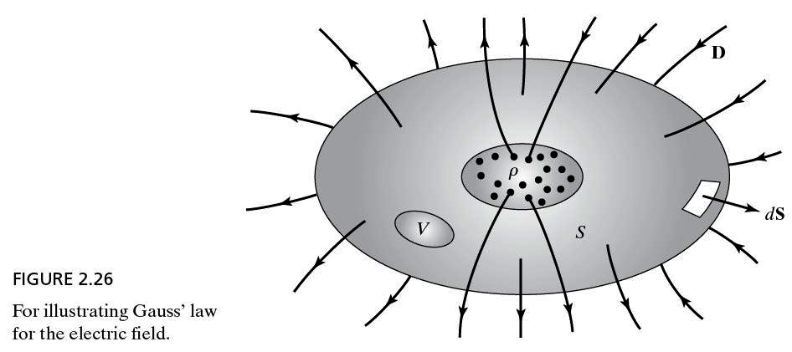
Electric Flux Density Vector (D)

Slide 29
Magnetic Field Intensity Vector
A magnetic field is a field produced by moving electric charges or electric currents, by electric fields that vary in time.

Slide 30
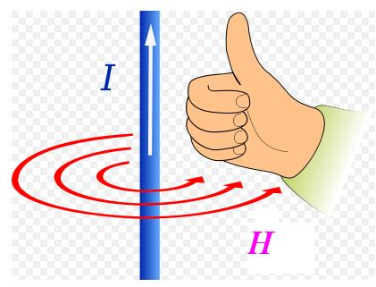
Magnetic Field Intensity Vector

Slide 31
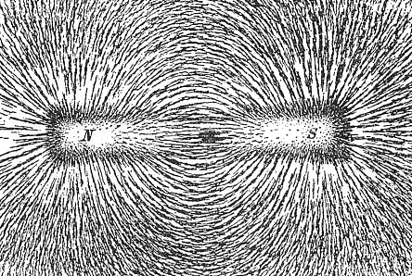
Magnetic Field Intensity Vector

Slide 32
Magnetic Flux Density Vector
Magnetic flux density is a vector quantity measuring the strength and direction of the magnetic field around a magnet or an electric current. Magnetic flux density is equal to magnetic field intensity times the magnetic permeability in the region in which the field exists.

Slide 33
Magnetic Flux Density Vector
Electric charges moving through a magnetic field are subject to a force described by the equation F_{m} = qυ × B, where q is the amount of electric charge, υv is the velocity of the charge, B is the magnetic flux density at the position of the charge, and × is the vector product. Magnetic flux density also can be understood as the density of magnetic lines of force, or magnetic flux lines, passing through a specific area. It is measured in units of tesla.

Slide 34
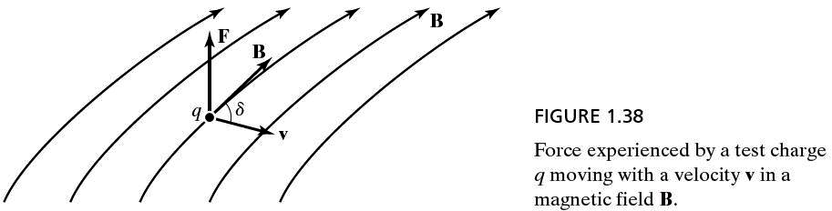
Magnetic Flux Density Vector

Slide 35
Magnetic Flux Density Vector
Why F_{m} = qυ × B?
Why not F_{m} = qυ × H?
The reason will become obvious
if the units of both sides are examined!!!
35

Slide 36
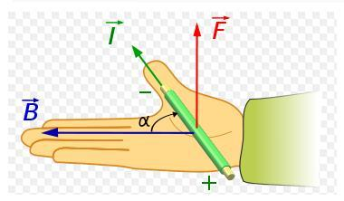
Magnetic Flux Density Vector

Slide 37
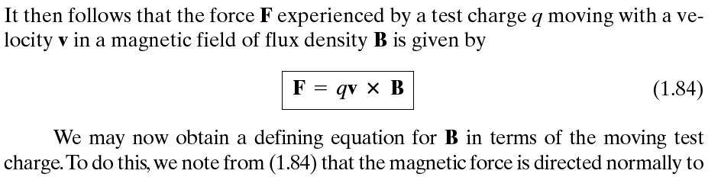
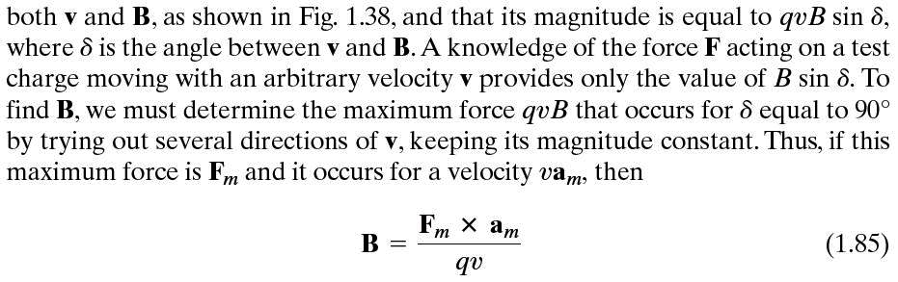
Magnetic Flux Density Vector

Slide 38
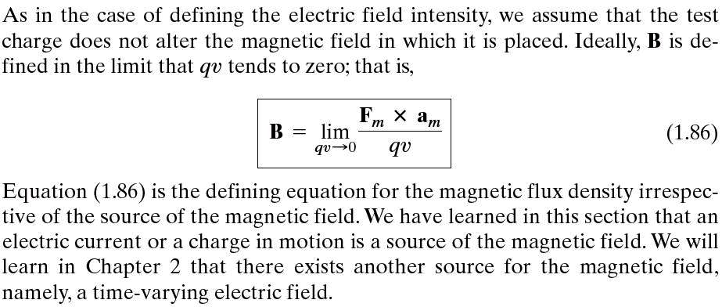
Magnetic Flux Density Vector

Slide 39
Magnetic Force
The magnetic flux density vector is quantitatively defined through the force on a small probe point charge q moving at a velocity υ in the magnetic flux, which equals the cross product of qυ and B.
39

Slide 40
Magnetic Flux Density
40

Slide 41
Magnetic Flux Density
41

Slide 42
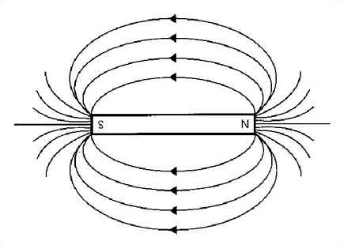
Magnetic Flux Density Vector

Slide 43
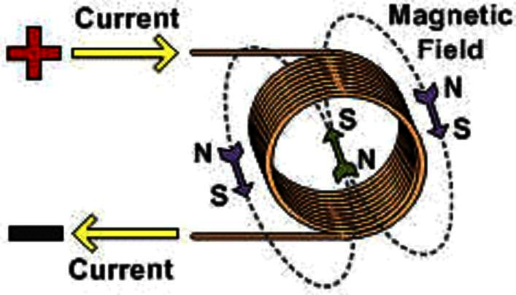
Magnetic Flux Density Vector

Slide 44
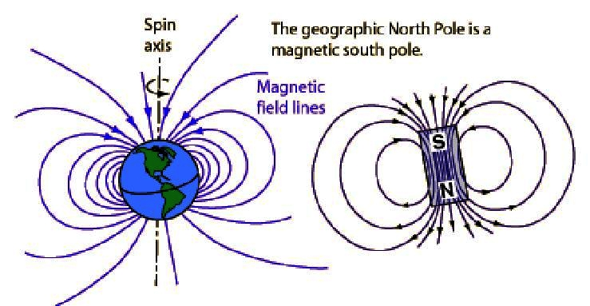
Magnetic Flux Density Vector

Slide 45
Magnetic Flux Density Vector
An aurora (plural: auroras or aurorae) is a natural light display in the sky particularly in the high altitude (Arctic and Antarctic) regions, caused by the collision of energetic charged particles with atoms in the high altitude atmosphere (thermosphere). The charged particles originate in the magnetosphere and solar wind and are directed by the Earth's magnetic field into the atmosphere.

Slide 46

Aurora Borealis

Slide 47
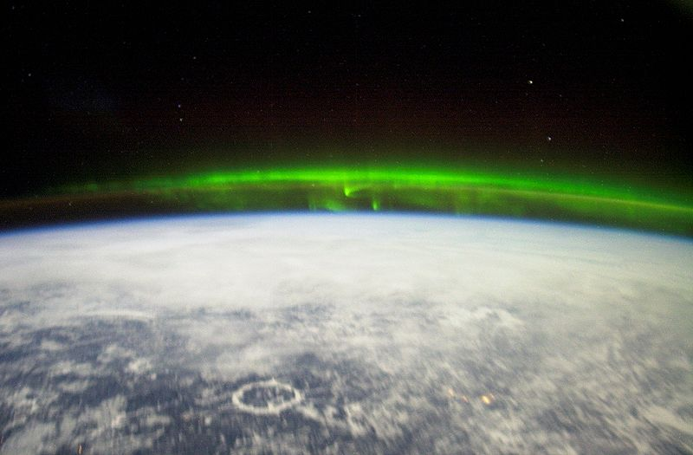
Aurora Borealis

Slide 48
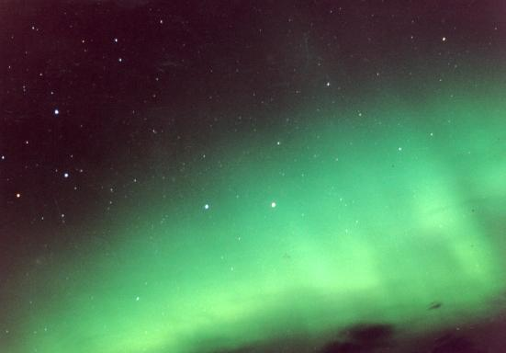
Aurora Australis

Slide 49
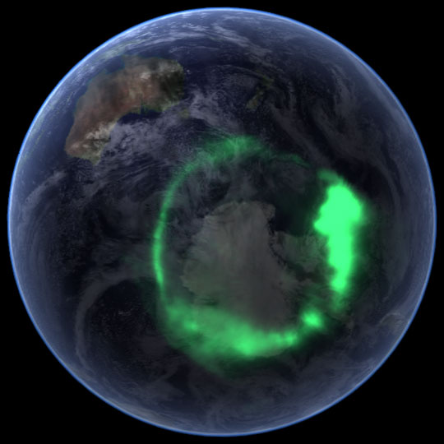
Aurora Australis

Slide 50
Biot-Savart Law
The Biot–Savart law is an equation in electromagnetism that describes the magnetic field B generated by an electric current. The vector field B depends on the magnitude, direction, length, and proximity of the electric current, and also on a fundamental constant called the magnetic constant. The law is valid in the magnetostatic approximation.

Slide 51
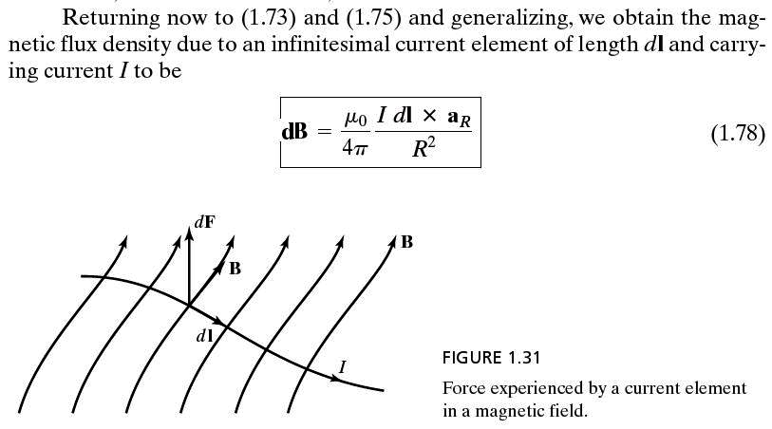
Biot-Savart Law

Slide 52
52
52

Slide 53
Maxwell’s Equations
Mathematically speaking, electromagnetics is the set of Maxwell’s equations, i.e., Faraday’s Law Gauss’ Law Generalized Ampere’s Circuital Law Conservation of Magnetic Flux (or No isolated Magnetic Charge)

Slide 54
Maxwell’s Equations in Integral Form
54
54

Slide 55
Integral and Differential Forms of
Faraday’s Law
55

Slide 56
Integral and Differential Forms of
Gauss’ Law
56

Slide 57
Integral and Differential Forms of
Ampere’s Law
57

Slide 58
Integral and Differential Forms of
Principle of Conservation of Magnetic Flux
58

Slide 59
Maxwell’s Equations in Differential Form
59
59

Slide 60
Maxwell’s Equations
How could the integral form of
the Maxwell’s equations
be converted to
the differential form???
The keys lie in
the divergence theorem and
the Stokes’ theorem,
which will be introduced later!!!
60

Slide 61
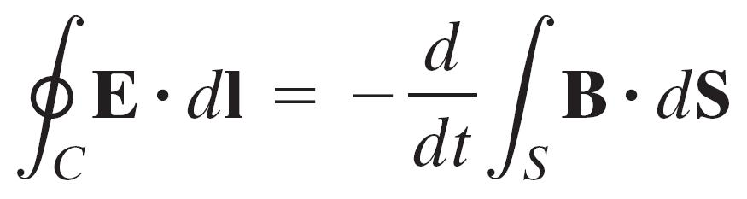
Faraday’s Law
The net electromotive force around a closed path (or contour) C is equal to the negative of the time rate of change of the magnetic flux enclosed by that closed path (or contour).

Slide 62
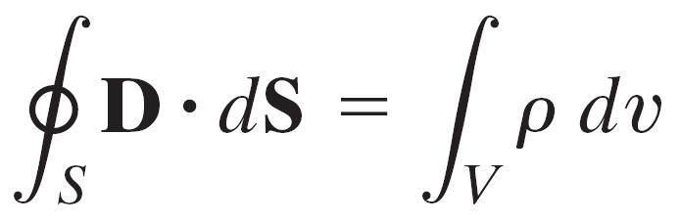
Gauss’ Law
The net electric flux emanating from a closed surface S is equal to the charge enclosed by that (Gaussian) surface.

Slide 63
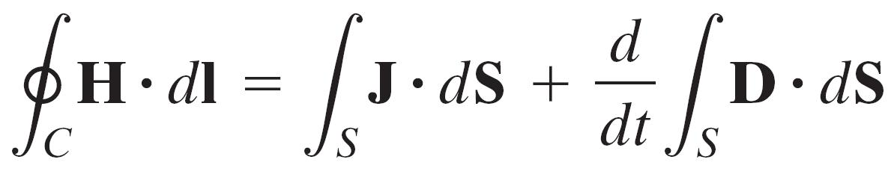
Generalized Ampere’s Circuital Law
The net magnetomotive force around a closed path (or contour) C is equal to the sum of the conduction current by that path (or contour) due to the actual flow of charges and the displacement current due to the time rate of change of the electric flux enclosed by that path (or contour).

Slide 64
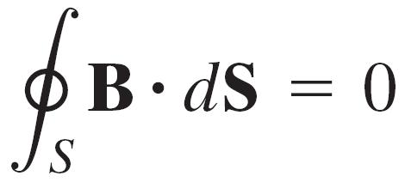
Conservation of Magnetic Flux
The net magnetic flux emanating from a closed surface S is equal to zero.

Slide 65
Maxwell’s Equations in Integral Form
65
65

Slide 66
Boundary Conditions
66
66

Slide 67
Maxwell’s Equations in Differential Form
67
67

Slide 68
Charge of an Electron
68

Slide 69
Circumference to Diameter Ratio
69

Slide 70
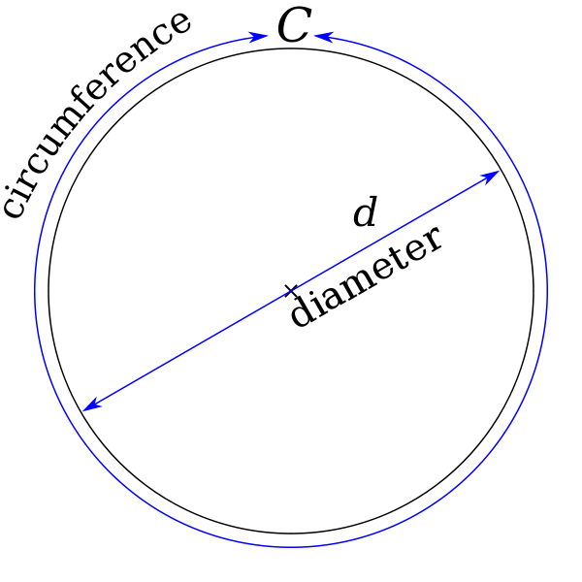
𝝅 = 3.14159265358979323846264338327950288419716939937510...
Source: https://en.wikipedia.org/wiki/Pi

Slide 71
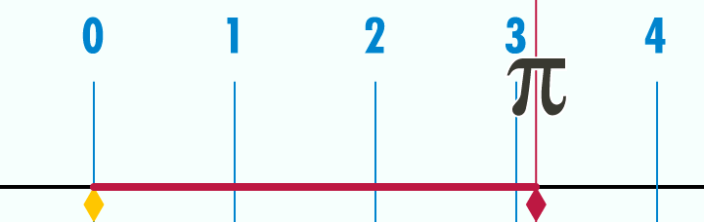
𝝅 = 3.14159265358979323846264338327950288419716939937510...
Source: https://en.wikipedia.org/wiki/Pi

Slide 72
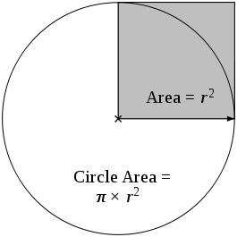
𝝅 = 3.14159265358979323846264338327950288419716939937510...
Source #1: https://en.wikipedia.org/wiki/Pi
Source #2: https://en.wikipedia.org/wiki/Monte_Carlo_method

Slide 73
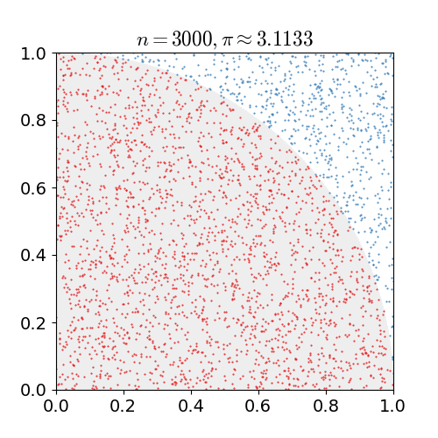
𝝅 = 3.14159265358979323846264338327950288419716939937510...
Source #1: https://en.wikipedia.org/wiki/Pi
Source #2: https://en.wikipedia.org/wiki/Monte_Carlo_method

Slide 74
Permittivity of Free Space
74

Slide 75
Permeability of Free Space
75

Slide 76
Speed of Light in Free Space
76

Slide 77
Review of Vector Analysis
77

Slide 78
Scalar Quantity
A quantity, such as mass, length, or width, that is completely specified by its magnitude and has no direction.
78

Slide 79
Vector Quantity
A quantity, such as velocity, completely specified by a magnitude and a direction.
79

Slide 80
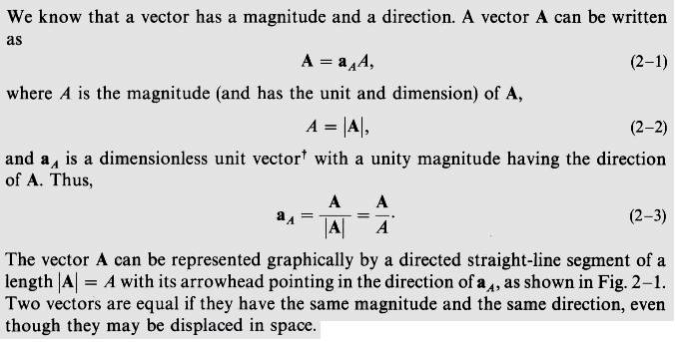
Vector Quantity
80

Slide 81
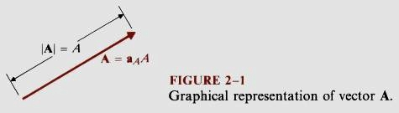
Vector Quantity
81

Slide 82
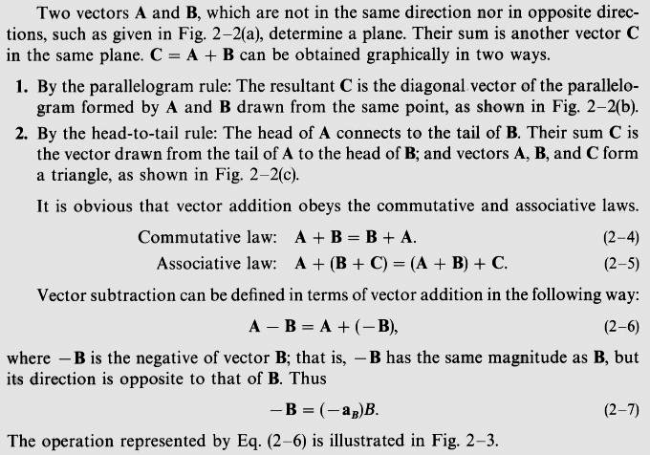
82

Slide 83
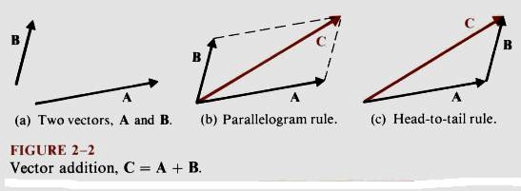
Vector Quantity
83

Slide 84
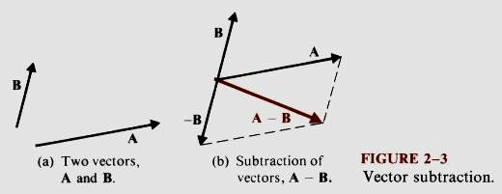
Vector Quantity
84

Slide 85
Field
A field is a spatial distribution of a quantity, which may or may not be a function of time.
85

Slide 86
Coordinate Systems
In geometry, a coordinate system is a system which uses one or more numbers, or coordinates, to uniquely determine the position of a point or other geometric element. The order of the coordinates is significant and they are sometimes identified by their position in an ordered tuple and sometimes by a letter, as in 'the x-coordinate'. In elementary mathematics the coordinates are taken to be real numbers.
86

Slide 87
Orthogonal Coordinates
In mathematics, orthogonal coordinates are defined as a set of d coordinates u = (u₁, u₂, ..., u_{d}), in which the coordinate surfaces all meet at right angles. A coordinate surface for a particular coordinate u_{k} is the curve, surface, or hypersurface on which u_{k} is a constant.
87

Slide 88
Orthogonal Coordinates
For example, the 3-dimensional Cartesian coordinates (x, y, z), cylindrical coordinates (r, φ, z), spherical coordinates (R, θ, φ).
88

Slide 89
Cartesian Coordinate System
Cartesian (x, y, z)
All three unit vectors are uniform.
89

Slide 90
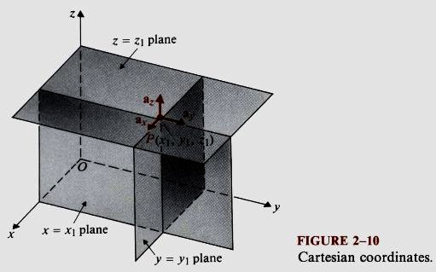
Cartesian Coordinate System
90

Slide 91
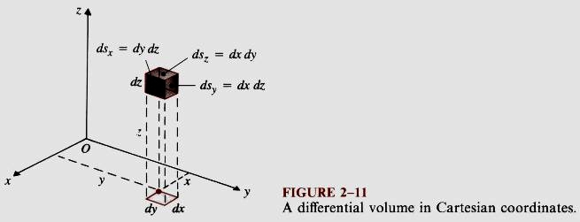
Cartesian Coordinate System
91

Slide 92
Right-Handed Cartesian Coordinate System
a_{x} , a_{y} , and a_{z} are uniform unit vectors, that is, the direction of each unit vector is the same everywhere in space.
92

Slide 93
Cylindrical Coordinate System
Cylindrical (r, φ, z)
Only a_{z} is uniform.
93

Slide 94
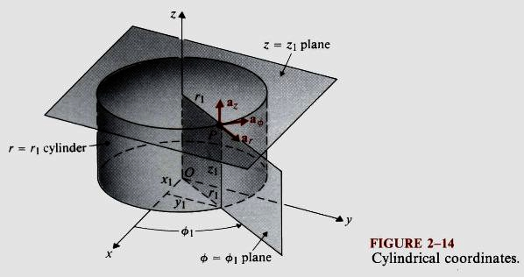
Cylindrical Coordinate System
94

Slide 95
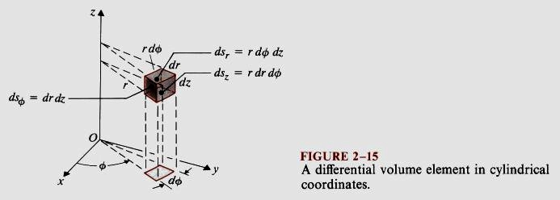
Cylindrical Coordinate System
95

Slide 96
Right-Handed Cylindrical Coordinate System
a_{r} and a_{φ} are non-uniform unit vectors, that is, the direction of each unit vector is different everywhere in space.
a_{z} are uniform unit vectors, that is, the direction of each unit vector is the same everywhere in space.
96

Slide 97
Spherical Coordinate System
Spherical (R, θ, φ)
All three unit vectors are non-uniform.
97

Slide 98
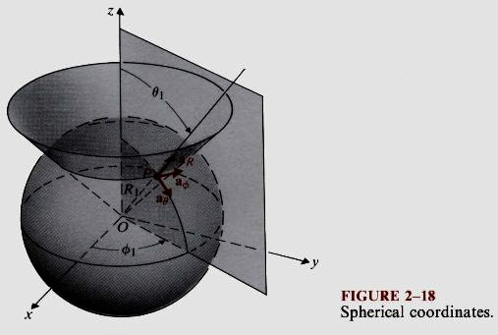
Spherical Coordinate System
98

Slide 99
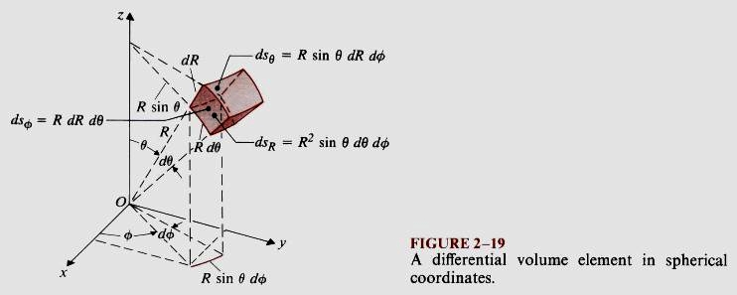
Spherical Coordinate System
99

Slide 100
Right-Handed Spherical Coordinate System
a_{R} , a_{Θ}, and a_{φ} are non-uniform unit vectors, that is, the direction of each unit vector is different everywhere in space.
100

Slide 101
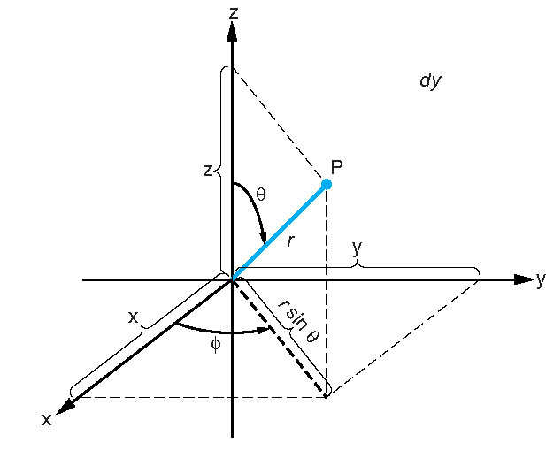
Figure 2.12 (p. 23) The spherical coordinate system is represented by the orthogonal points (R, θ, φ).
101

Slide 102
Conversion of Coordinates Between Coordinate Systems
102

Slide 103
Conversion of Coordinates Between Coordinate Systems
103

Slide 104
Conversion of Vectors Between Coordinate Systems
104

Slide 105
Conversion of Vectors Between Coordinate Systems
105

Slide 106
Metric Coefficients
Metric coefficients are the factors that relate orthogonal differential lengths to orthogonal coordinates. dℓ_{i} = h_{i}du_{i}, i = 1, 2, 3
106

Slide 107
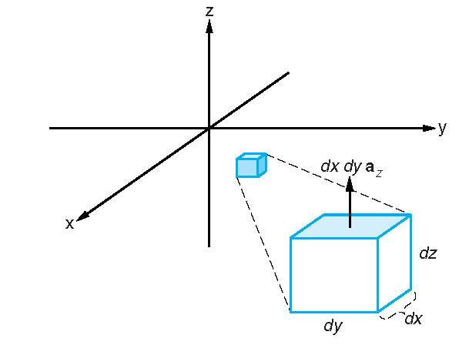
Figure 2.6 (p. 18) A differential volume in Cartesian coordinates shows an expanded inset with sides dx, dy, and dz. The differential surface vector dS = dxdya_{z} is shaded.
107

Slide 108
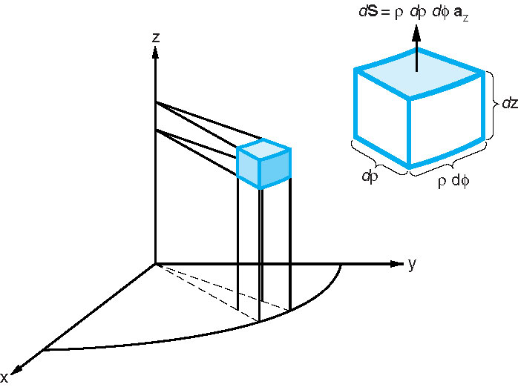
Figure 2.17 (p. 28) A differential element in cylindrical coordinates.
108

Slide 109
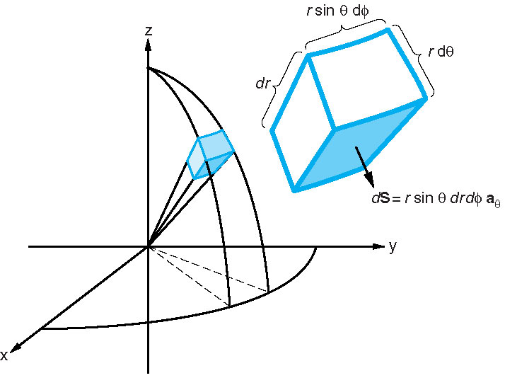
Figure 2.14 (p. 25) A differential element in the spherical coordinate system. One of the element's six surfaces is shaded with the differential surface vector indicated.
109

Slide 110
Metric Coefficients
Cartesian coordinates: h_{x} = 1, h_{y} = 1, h_{z} =1 cylindrical coordinates (r, φ, z): h_{r} = 1, h_{φ} = r, h_{z} = 1 spherical coordinates (R, θ, φ): h_{R} = 1, h_{θ} = R, h_{φ} = r = Rsinθ
110

Slide 111
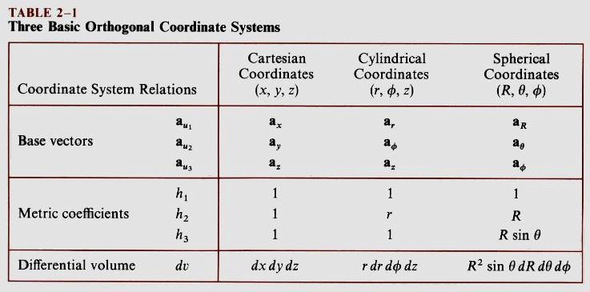
Metric Coefficients
111

Slide 112
Position Vector
A vector is generally not a coordinate or coordinates which are used to describe the position of a point in space. However, in geometry, a position, location, or radius vector is a vector which represents the position of a point P in space in relation to an arbitrary reference origin O. It corresponds to the displacement from O to P. The concept applies to 2- or 3-dimensional space.
112

Slide 113
Position Vector
The position vector is defined as the geometric vector going from the origin to the point of interest.

Slide 114

Direction of Elemental Surface
114

Slide 115

Dot or Scalar Product
115

Slide 116

Dot or Scalar Product
116

Slide 117
Dot or Scalar Product
117

Slide 118

118

Slide 119


Cross or Vector Product
119

Slide 120

Cross or Vector Product
120

Slide 121

121

Slide 122
Cross or Vector Product
122

Slide 123

Scalar Triple Product
123

Slide 124

Vector Triple Product
124

Slide 125

125

Slide 126
Gradient
The gradient of a scalar field is a vector that provides us with both the direction in which the scalar field changes most rapidly and the magnitude of the maximum space rate of change. This property of the gradient operation is extensively used in numerous applications in all areas of science and engineering.
126

Slide 127
Gradient
127

Slide 128
Gradient
128

Slide 129
Gradient
129

Slide 130
Divergence
The divergence of a vector field at a given point is the net outflow of the flux of the vector field per unit volume as the volume shrinks about the point. The divergence of a vector field is a measure of sources that produce radial field components with respect to that point. Gauss’ law tells us that the sources producing locally radial electric field components in the case of electrostatic field are elemental charges dq.
130

Slide 131

Divergence
131

Slide 132
Divergence
132

Slide 133
Divergence
133

Slide 134

Divergence
134

Slide 135

Divergence Theorem
135

Slide 136
Divergence Theorem
136

Slide 137
Divergence Theorem
In words, the divergence theorem states that the net outward flux of a vector field through S equals the volume integral of the divergence of that field throughout the volume v bounded by S.
137

Slide 138
Integral and Differential Forms of
Gauss’ Law
138

Slide 139
Integral and Differential Forms of
Principle of Conservation of Magnetic Flux
139

Slide 140
Curl
The curl of a vector field gives the maximum net circulation of the vector field per unit area with the area of the surface element tending to zero and the direction of the curl of the vector field that gives the maximum value for the magnitude of the net circulation per unit area.
140

Slide 141
Curl
The curl of a vector field may be regarded physically as a measure of those local sources of the vector field at a point in space which produce circular field components with respect to that point. Ampere’s law tells us that the sources producing locally circular magnetic field components in the case of the magnetostatic field are elemental currents dI.
141

Slide 142


Curl
142

Slide 143
Curl
143

Slide 144

Curl
144

Slide 145

Curl
145

Slide 146

Curl
146

Slide 147
Curl
147

Slide 148
Curl
148

Slide 149

Stokes’ Theorem
149

Slide 150
Stokes’ Theorem
150

Slide 151
Stokes’ Theorem
In words, Stokes theorem states that the net circulation of a vector field along an arbitrary contour is the same as the net flux of its curl through any surface bounded by the contour, where the reference orientations of the contour and the surface are interconnected by the right-hand rule.
151

Slide 152
Integral and Differential Forms of
Faraday’s Law
152

Slide 153
Integral and Differential Forms of
Ampere’s Law
153

Slide 154
1st Null Identity
The curl of the gradient of any scalar field is identically zero assuming that the scalar field and its first derivatives exist everywhere.
154

Slide 155
2nd Null Identity
The divergence of the curl of any vector field is identically zero assuming that the vector field and its first derivatives exist everywhere.
155

Slide 156
Helmholtz’s Theorem
Helmholtz’s theorem states that a vector field is determined to within an additive constant if both its divergence and its curl are specified everywhere.
156

Slide 157
Helmholtz’s Theorem
157

Slide 158
Coulomb’s Force
158

Slide 159
Electric Field Intensity Due to Point Charge
159

Slide 160
Graphical Addition of Vectors
160

Slide 161

Graphical Addition of Vectors
161

Slide 162
Electric Field Intensity Due to Point Charge
162

Slide 163
Electric Field Intensity
Due to System of Discrete Charges
163

Slide 164
Electric Field Intensity Due to Elemental Charge
164

Slide 165
Electric Field Intensity
Due to Continuous Charge Distribution
165

Slide 166

Electric
Field
Intensity
Vector
Due to
Charged
Ring
166

Slide 167
Electric Field Intensity Due to Charged Ring
167

Slide 168

Electrostatic Potential
168

Slide 169
Electrostatic Potential
Definition #1: The electrostatic scalar potential or simply electrical potential is defined through the mechanic work done by the external force, that is, the mechanic force in moving a unit charge from the reference point 1 (of lower potential) to the particular point 2 (of higher potential) along the given path.
Definition #2: The electrostatic scalar potential or simply electrical potential is defined through the work done by the electric field, that is, the electric force in moving a unit charge from a particular point 2 (of higher potential) to the reference point 1 (of lower potential) along the given path.
169

Slide 170
Electrostatic Potential Due to Point Charge
170

Slide 171

Electrostatic Potential Is Path-Independent
171

Slide 172
Electrostatic Potential Is Path-Independent
Think about the voltage between the positive and negative terminals of a commonly-used AAA alkaline dry battery.
Does the voltage of the battery change with the way the external connecting wire(s) is (are) run in the circuit of interest?
172

Slide 173

Electrostatic Potential Due to Point Charge
173

Slide 174
174

Slide 175
Electrostatic Potential
Due to System of Discrete Charges
175

Slide 176
Electrostatic Potential Due to Elemental Charge
176

Slide 177
Electrostatic Potential
Due to Continuous Charge Distribution
177

Slide 178
Electrostatic
Potential
Due
to
Charged
Ring
178

Slide 179
Electrostatic Potential Due to Charged Ring
179

Slide 180
Kirchhoff’s Voltage Law
180

Slide 181
Relationship Between E and V
181

Slide 182
Electrical
Field
Intensity
Vector
Due
to
Charged
Ring
182

Slide 183
Electric Field Intensity Due to Charged Ring
183

Slide 184
Electric Field Intensity Due to Charged Ring
184

Slide 185
Electric Field Intensity Due to Charged Ring
185

